Slide 1
This is what we did for NodeOrders

Slide 2
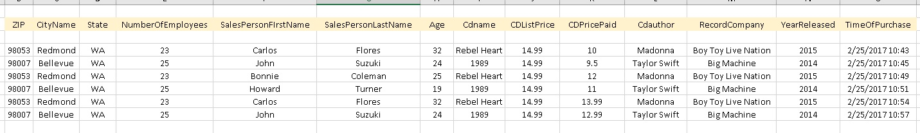
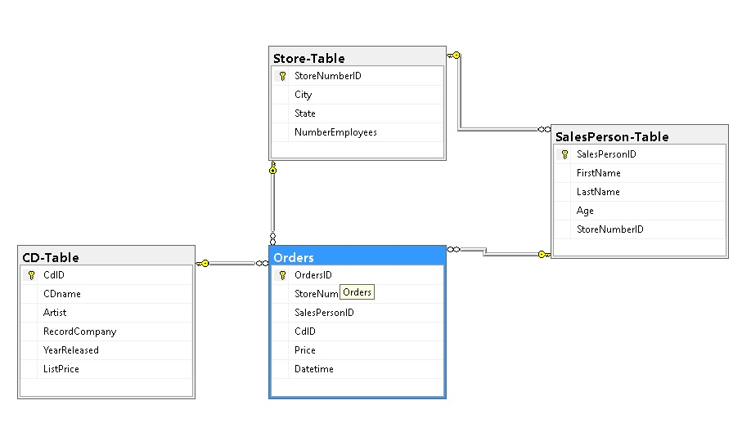

Slide 3
Steps – see images showing some steps
take raw PIG data
using selected subsets of rows, create 2 or more spreadsheets, one for each table you want
sort by key, and remove duplicates in the "dimension" spreadsheets.
Use SSMS, create new Database, and new tables for each spreadsheet.
Set appropriate column to be primary key (click on the little yellow key icon), do not tell SQL to autogenerate key.
create a table diagram and set up the PK FK relationships
import each XLS into each table
Do the "dimension tables" first, as they can be created with no referential integrity issues.
Lastly, do your "data" table, which will have foreign keys that must exist in the other tables.
Look over the SSIS.PPTX from when we did the node project first, then this PPT

Slide 4
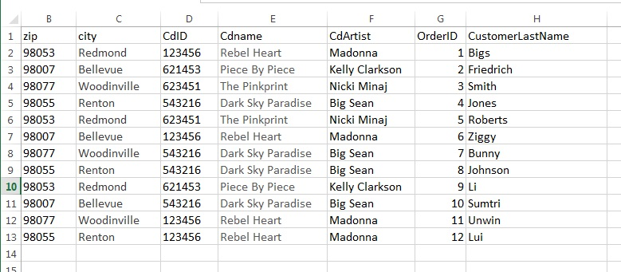
Pretend raw data output from my PIG job.
I decide to make zip-city and CdID-Cdname-CdArtist 2 separate tables.

Slide 5
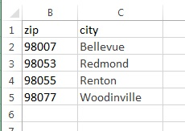
Take 2 rows from first spreadsheet, get rid of duplicates, and save.

Slide 6
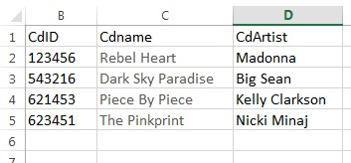
Take 3 rows from first spreadsheet, get rid of duplicates, and save.

Slide 7
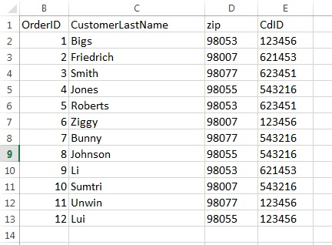
Then make a “data” spreadsheet from the first spreadsheet, by removing
City, Cdname, and CdArtist columns, but keeping their “foreign” keys.
I now have 3 tables to import, but first need to create the DB and 3 tables to import into.

Slide 8
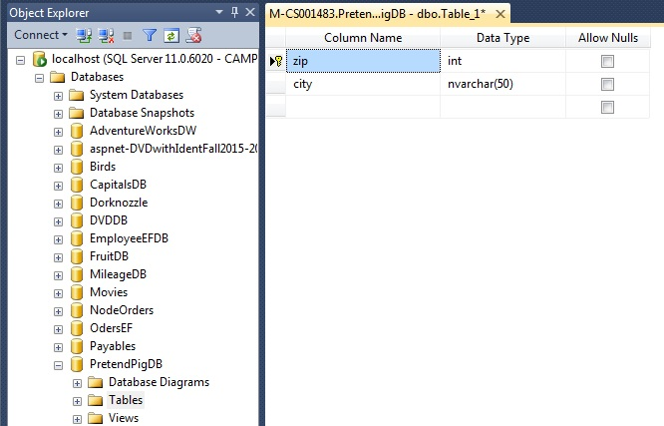
Create zip table

Slide 9
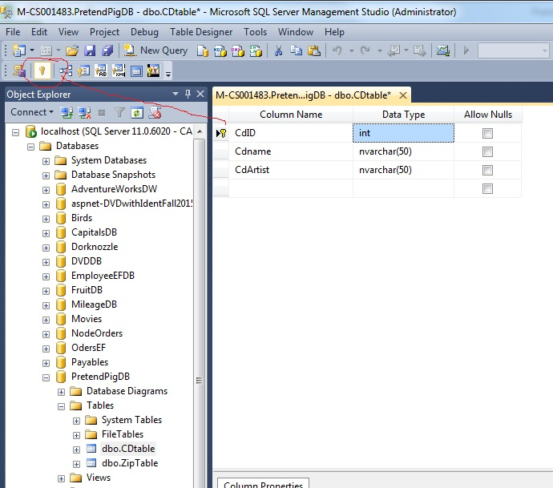
Create cd table

Slide 10
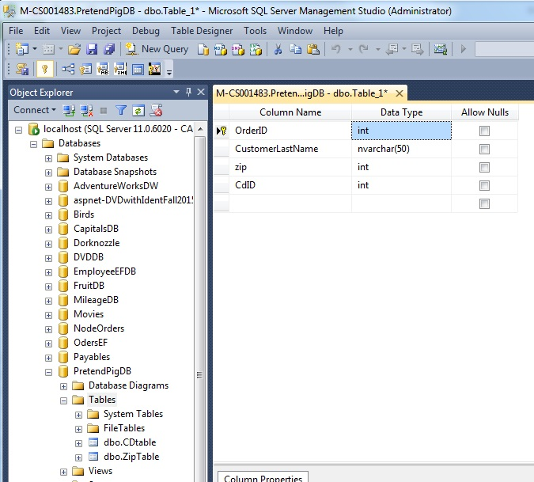
Create order table

Slide 11
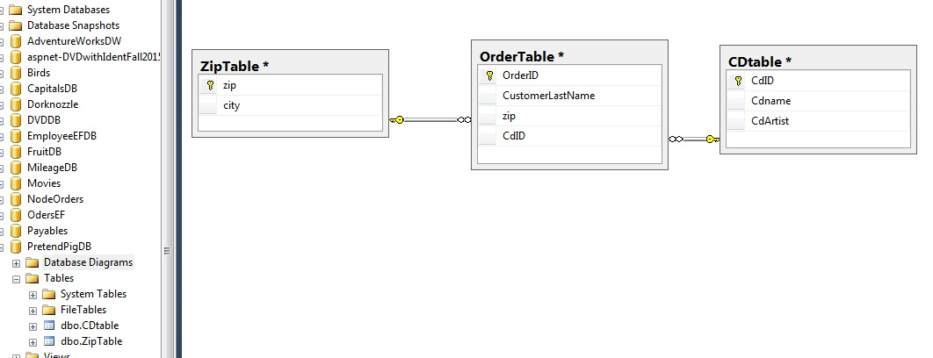
Using diagram, create PK-FK relationships

Slide 12
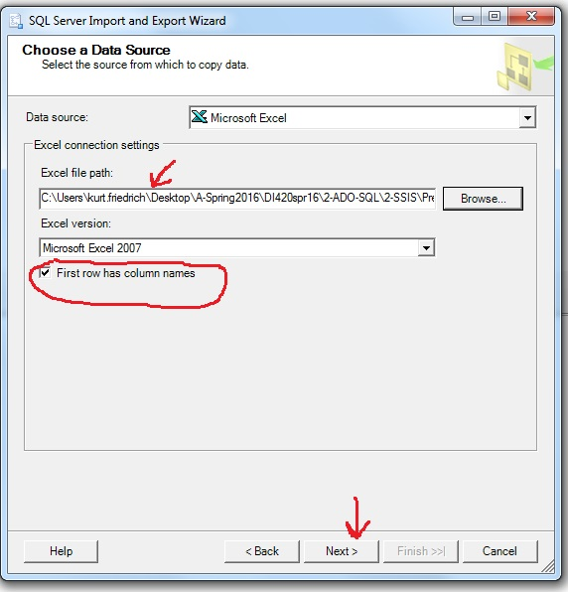
Import first table.

Slide 13
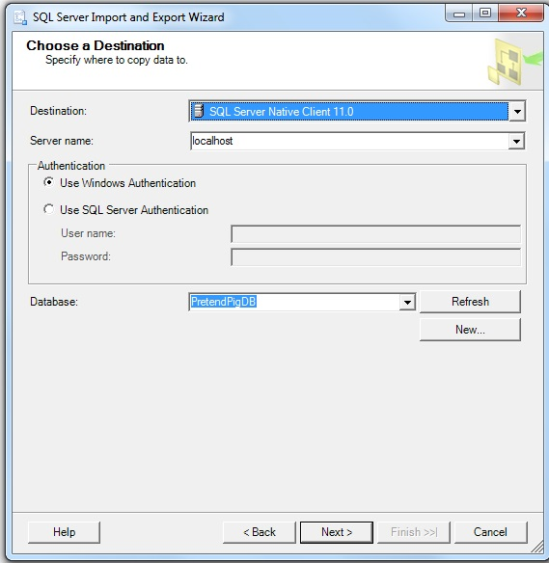

Slide 14
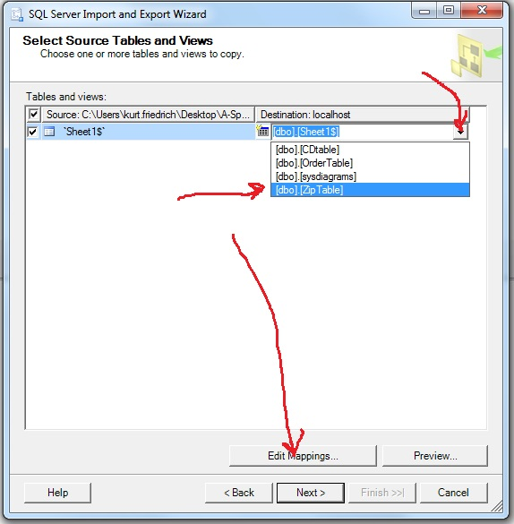

Slide 15
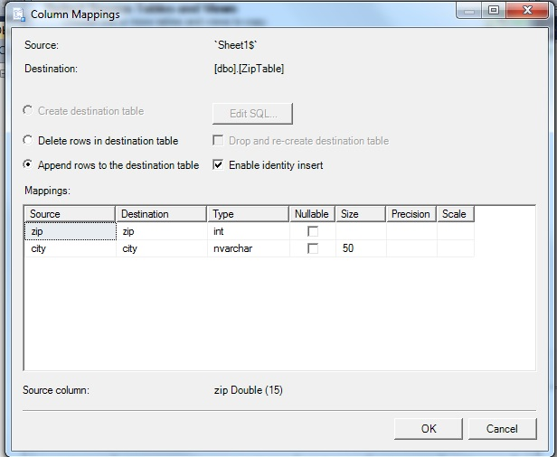

Slide 16
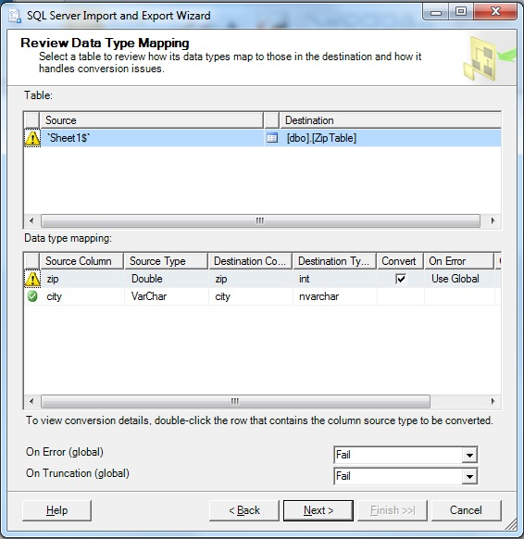

Slide 17
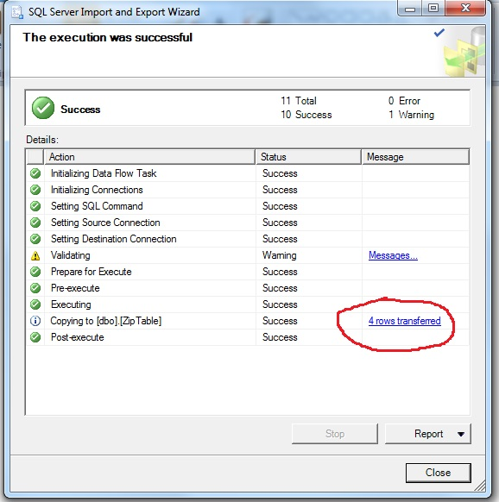

Slide 18
Then I did same for my Cdtable
Lastly I did same for my order table, which depended on the other 2 existing with valid keys
Next pic shows the successful order table

Slide 19
